Slide 1
Jet set Mars
Just woke up team

Slide 2
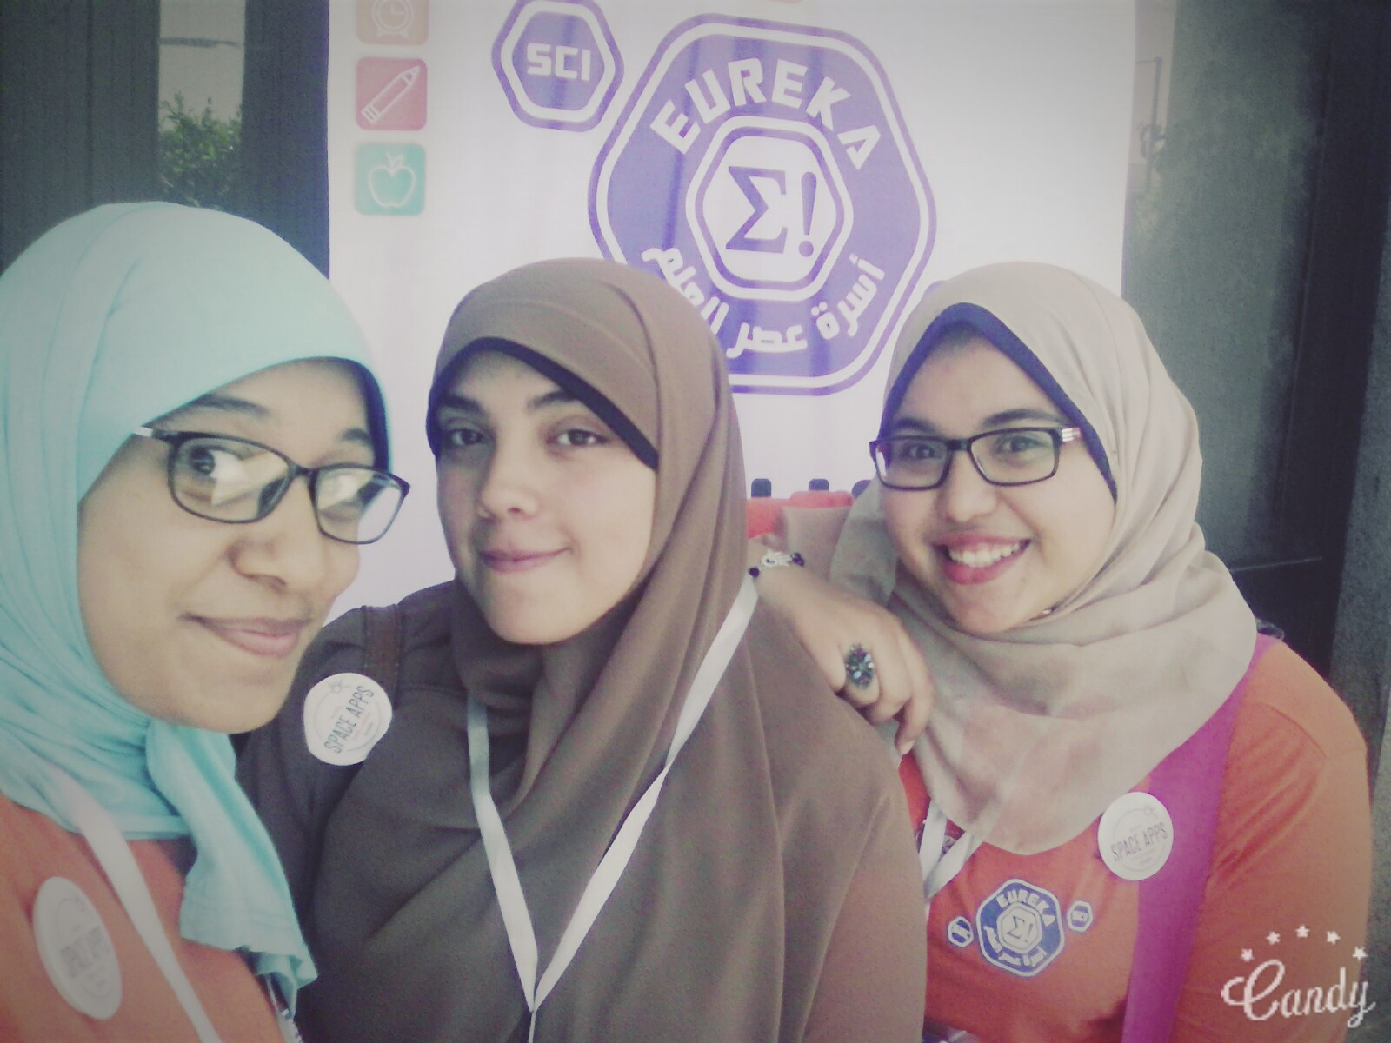
Our team consists of 3 competitors Hadeer – Manar - Yara
faculty of science suez canal university
2nd grade
Chemistry department
Our team combined on using physical and chemical fields to solve the problem

Slide 3
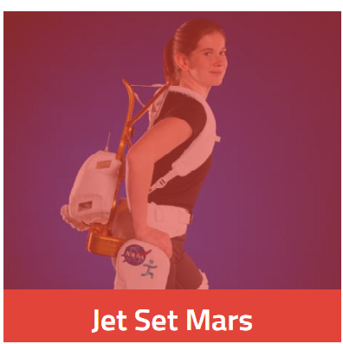
Our project
As we need to explore Mars in a better way without causing much damage.
The problem was how to make astronauts easily move on Mars with balance as the gravity on Mars is 3.7 m\s2 .
As we use an available product , cheap, and easy to use.

Slide 4
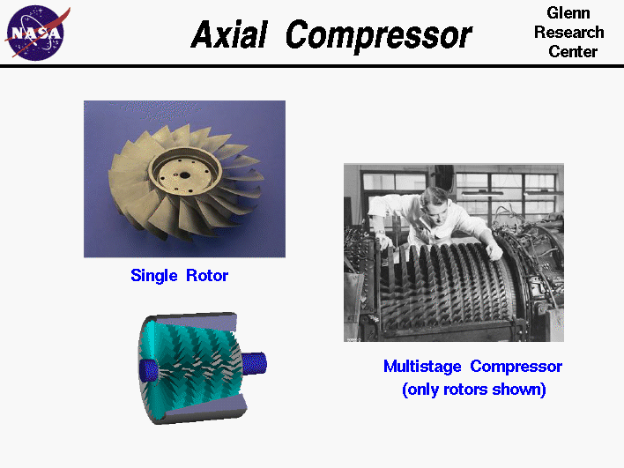
The solution
Mars’s atmosphere is almost 95.3% of carbon dioxide.
Our solution goes around developing a jet pack
using CO2 to lift up the astronauts and Axial
compressor.

Slide 5
Advantages & Disadvantages of the project
Our project makes it much easier for scientists to study the earth features.
Our project facilities the mobility of the astronauts on the different conditions of Mars.
Our project needs energy for the Axial compressor and its battery, and this might be the main disadvantage.
This project needs time, effort, fund, and a well prepared laboratory with several kinds of materials.

